Slide 1
IBM Advanced Data Science Capstone
Credit Card Default prediction
By Sreenivasulu parimi

Slide 2
Agenda
Background
Use Case
Approach
Data Overview
Data Exploration and Visualization
Preprocess - Feature Engineering
Model Selection
Model Evaluation
Conclusion

Slide 3
background
A Taiwan-based credit card issuer wants to better predict the likelihood of default for its customers, as well as identify the key drivers that determine this likelihood.
It would also help the issuer have a better understanding of their current and potential customers, which would inform their future strategy, including their planning of offering targeted credit products to their customers.

Slide 4
Use case
Identify the key drivers that determine the likelihood of credit card default.
Predict the likelihood of credit card default for customers of the Bank.

Slide 5
Approach
The approach that used here is Supervised learning Algorithm.
The idea behind using this is have a prior knowledge on our output values
It acts as a guide to teach the algorithms what conclusion it should come up with
Common algorithms in supervised learning includes logistic regression, naive bayes, support vector machines and decision tree classifier

Slide 6
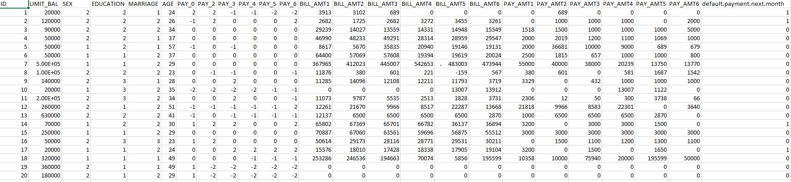
Data Overview
The dataset is available at https://archive.ics.uci.edu/ml/datasets/default+of+credit+card+clients
The data has 30000 observations and 25 attributes

Slide 7
Data Overview continue…
Features description:
LIMIT_BAL: Amount of the given credit (NT dollar): it includes both the individual consumer credit and his/her family (supplementary) credit.
SEX: Gender (1 = male; 2 = female).
EDUCATION: Education (1 = graduate school; 2 = university; 3 = high school; 4 = others).
MARRIAGE: Marital status (1 = married; 2 = single; 3 = others).
AGE: Age (year).
PAY_0 to PAY_6: History of past payment.
BILL_AMT1 to BILL_AMT6: Amount of bill statement (NT dollar)
PAY_AMT1 to PAY_AMT6: Amount of previous payment (NT dollar).
default payment next month: positive class: default | negative class: pay

Slide 8
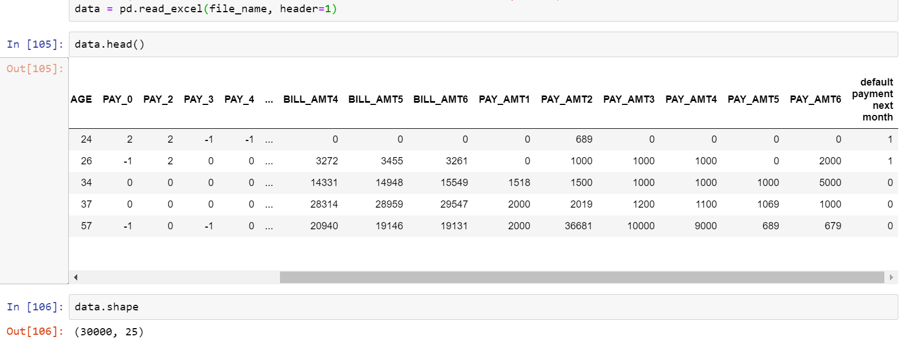
Data exploration and visualization
In the data set, there are 30000 observations and 25 features

Slide 9
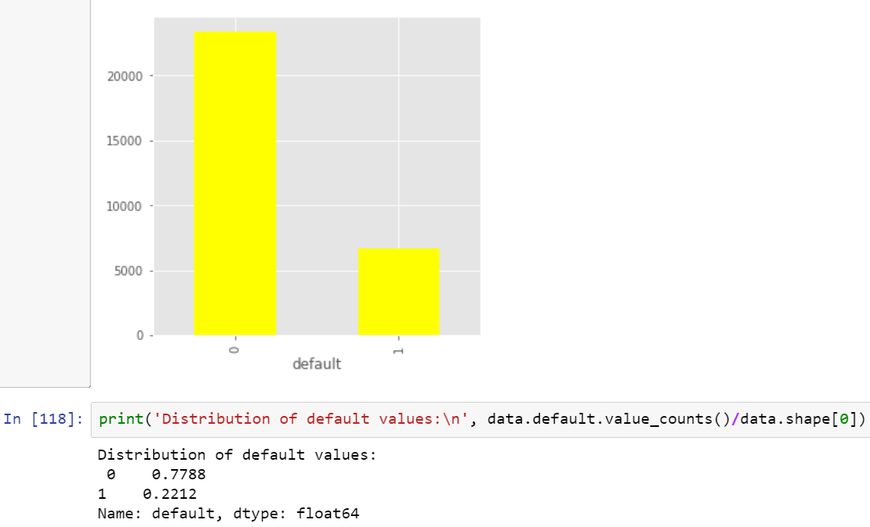
Data exploration and visualization continue…
The visual shows the total number of observations for defaulters and non – defaulters
If they would do payment or not (yes = 1, no = 0) for the next month
22% - default
78% - non-default

Slide 10
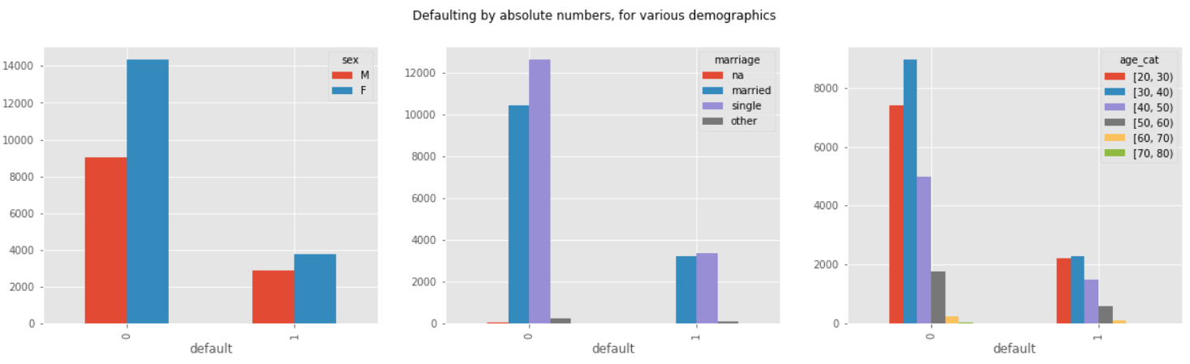
Data exploration and visualization continue…
This graph shows the default distribution with various customer demographics such as age, sex and marital status.

Slide 11
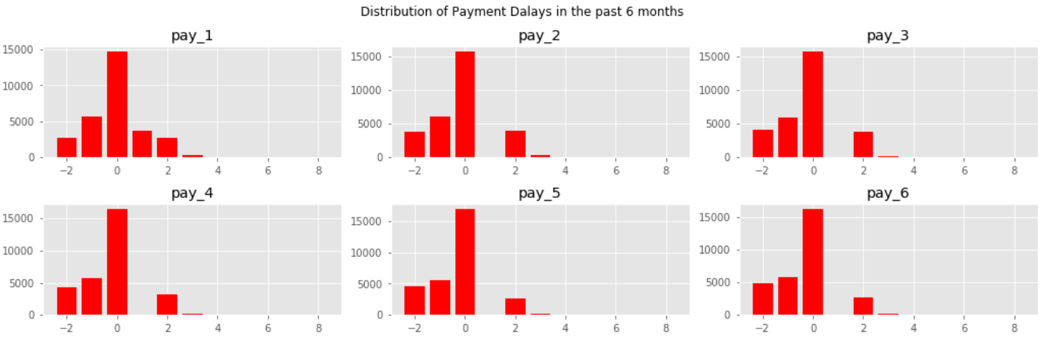
Data exploration and visualization continue…
The above picture shows that some customers pay 2 months, others 1 month upfront whereas most of them are on par and few are running behind payments.

Slide 12
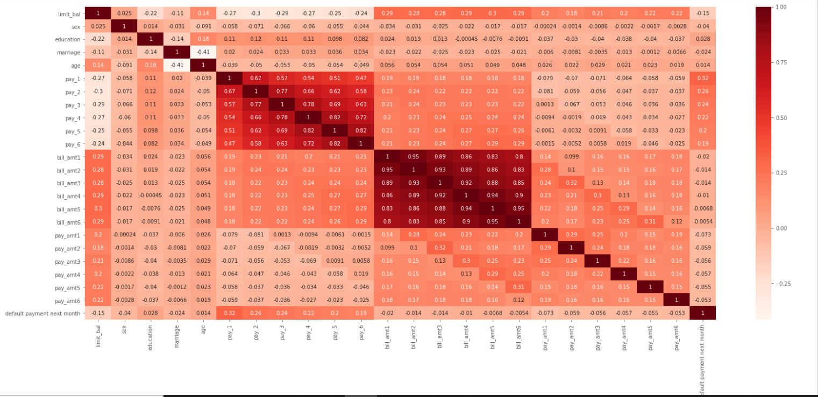
Data exploration and visualization continue…
This graph represents how attributes correlated among each other and their strength of relationship.
Pay_1 to Pay_6 features are reasonably positive correlation with the default.

Slide 13
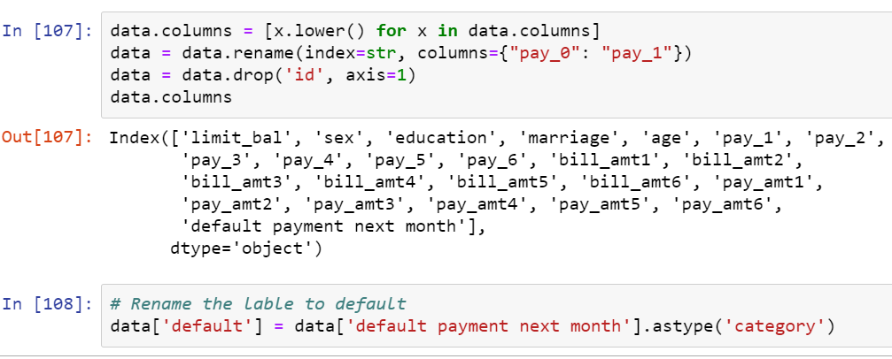
Preprocess - feature engineering
There are no blank/null values in the data set
ID attribute was dropped as its not required for this modeling
Renamed the feature Pay_0 in to Pay_1
Converted the attribute default payment next month type to category and stored the values in default which our target variable

Slide 14
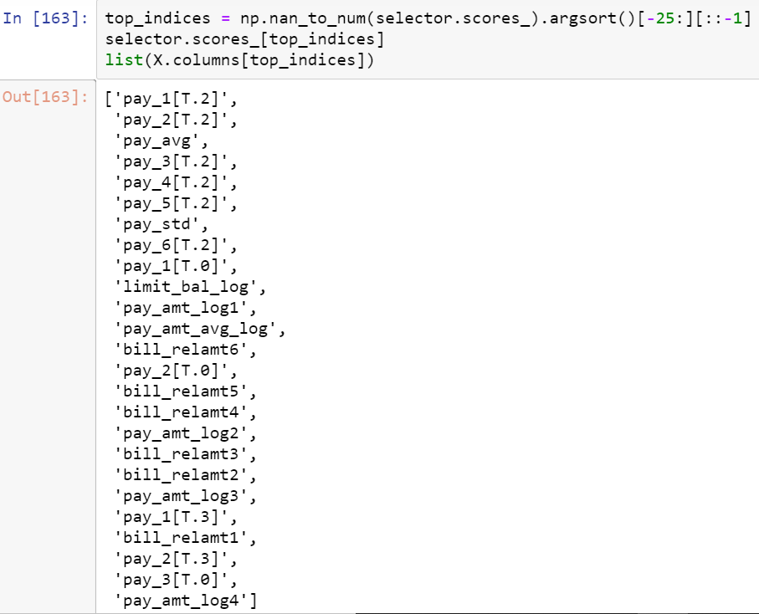
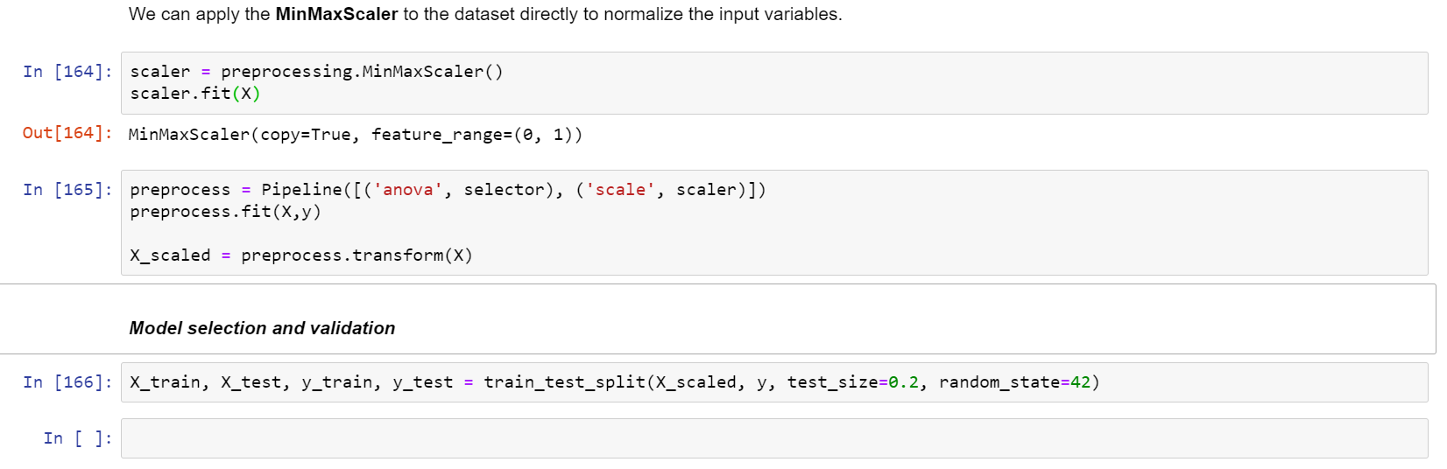
Preprocess - feature engineering continue…
Extracted few new features by applying transformation such as mean, standard deviation, and log etc.
Extracted above top 25 most important features in the final modeling
Applied One - Hot Encoding on the data
Applied MinMaxScaler to normalize the data
Training & Testing Data Split:- Data set is divided in 80:20 ratio for train and test respectively

Slide 15
Model selection
Logistic Regression
Used for Binary classification and Based on Probability
Outputs have a probabilistic interpretation, and the algorithm can be regularized to avoid over fitting
The conditional probability p of class belongs to 1 if probability >= threshold (default 0.5) else it belongs to class 0
Random Forest
It is an ensembled model built on decision trees
It builds multiple decision trees and merges them together to get a more accurate and stable prediction
Artificial Neural Network
Neural Network is used with backpropagation algorithm to select optimum weights of predictors. The following architecture and hyper parameters used.
Input Layer 26 Hidden Layer 26 Output Layer 1
Epochs 10 Optimizer ADAM Activation function ReLU and Sigmoid Loss function Binary cross entropy

Slide 16
Model Evaluation
The following model metrics used to evaluate the model performance
Accuracy: Determine how often the model predicts default and non-default correctly
(TP + TN)/(TP + TN + FP + FN)
AUC - ROC curve: It is a probability curve and AUC represents degree or measure of separability. It tells how much model is capable of distinguishing between the classes. Higher the AUC, better the model is at predicting 0s as 0s and 1s as 1s.
Precision: Calculates whenever our model predicts it is default how often it is correct
TP/(TP + FP)
Recall: Regulate the actual default that the model is actually predict
TP/(TP + FN)

Slide 17
Model Evaluation Continue…
Confusion Matrix
True Positive: A customer who is actually defaulter and our model predicted it as defaulter
True Negative: A customer who is actually non-defaulter and our model predicted it as non-defaulter
False Positive (Type I error): A customer who is actually non-defaulter but our model predicted it as defaulter
False Negative (Type II error): A customer who is actually defaulter but our model predicted it as non-defaulter
 | Non-defaulter (predicted) - 0 | Defaulter (predicted) - 1
Non-defaulter (actual) - 0 | True Negative | False Positive
Defaulter (actual) - 1 | False Negative | True Positive

Slide 18
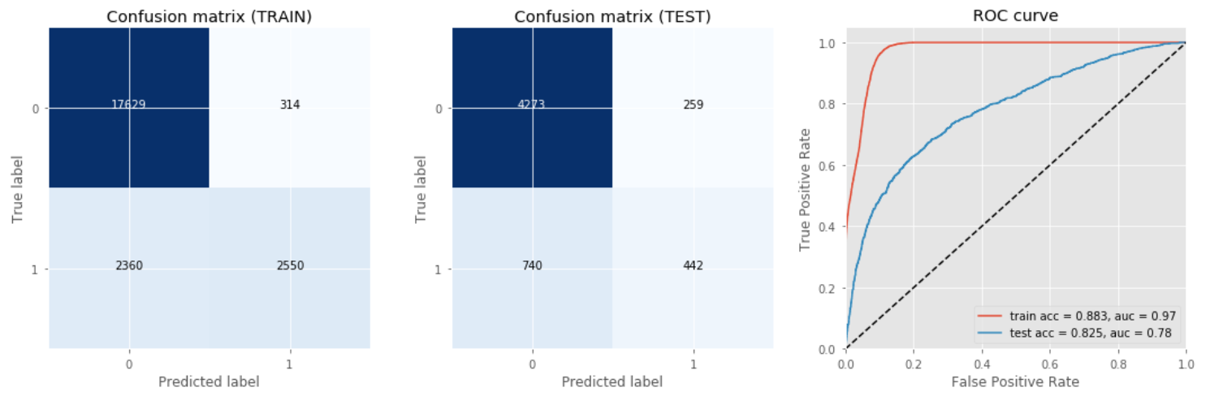
Model Evaluation continue…
Random Forest Model with threshold 0.5

Slide 19
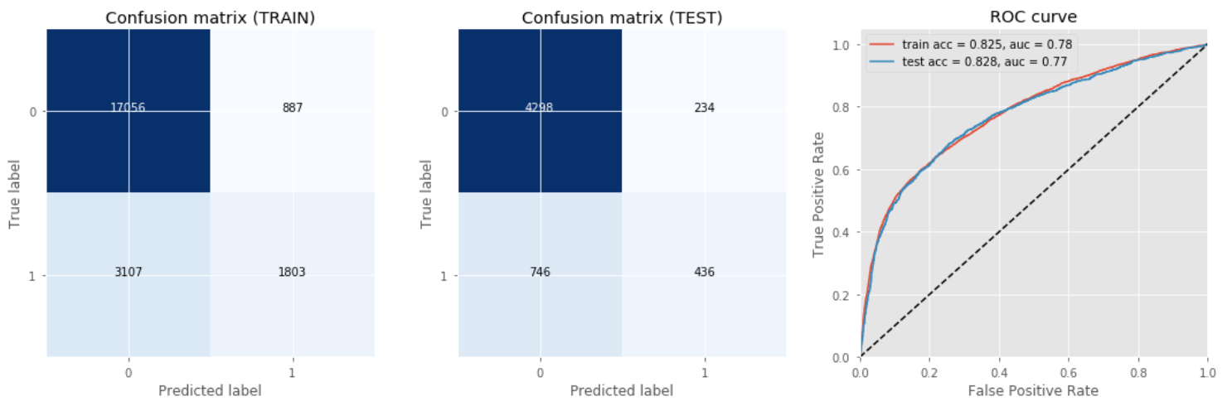
Model Evaluation continue…
Logistic Regression Model with threshold 0.5

Slide 20
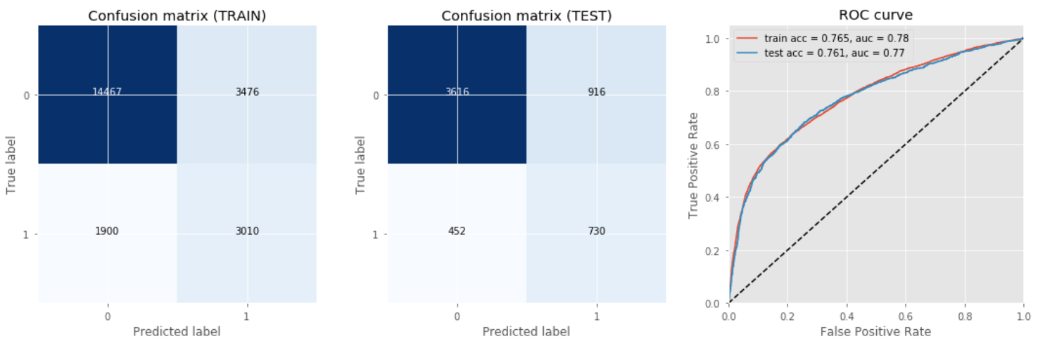
Model Evaluation continue…
Logistic Regression Model with threshold 0.2

Slide 21
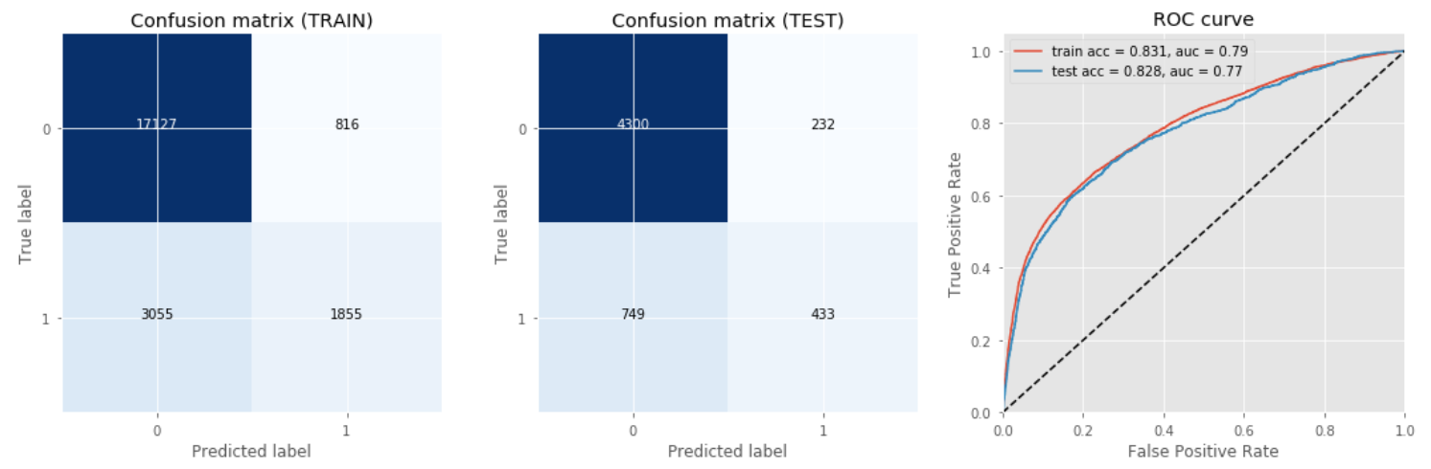
Model Evaluation continue…
Deep Learning Model with threshold 0.5

Slide 22
Evaluation result/outcome
Model | AUC | Accuracy | Precision | Recall | Confusion Metrix
Dummy/Null | - | 0.793 | - | - | -
Random Forest | 0.78 | 0.825 | 0.631 | 0.374 | 4273 | 259
 |  |  |  |  | 740 | 442
Logistic Regression | 0.77 | 0.828 | 0.651 | 0.368 | 4298 | 234
 |  |  |  |  | 746 | 436
ANN | 0.77 | 0.828 | 0.651 | 0.366 | 4300 | 232
 |  |  |  |  | 749 | 433
Logistic Regression (Threshold 0.2) | 0.77 | 0.761 | 0.443 | 0.618 | 3616 | 916
 |  |  |  |  | 452 | 730

Slide 23
conclusion
Explored & visualized the data and understand the relationship among the features and target
Used train and validation data split to evaluate the model performance to predict the target i.e. detecting whether a credit card client will default next month or not
Accuracy of the Dummy classifier is 0.793
Among the models (logistic Regression, Random Forest & Deep Learning), Logistic Regression & Deep learning models perform well and the accuracy of the models is more than base/dummy model as well.
If we set threshold value is 0.2, then False Negative (Type II error) is improved by 40%

Slide 24
Links
Dataset: https://archive.ics.uci.edu/ml/datasets/default+of+credit+card+clients
Github: https://github.com/sreenivasulu-parimi/IBMAdvancedDataScienceCapstone
ADD: https://github.com/sreenivasulu-parimi/IBMAdvancedDataScienceCapstone/blob/main/Architectural%20Decisions%20Document.pdf
Notebook: https://github.com/sreenivasulu-parimi/IBMAdvancedDataScienceCapstone/blob/main/IBM%20Advance%20Data%20Science%20Capstone%20Note%20Book.ipynb

